Slide 1
Profiling Greenhouse Gas Emissions (GHGs) in Pennsylvania
How does PA contribute to an issue we know must be resolved?
By: Megan Spriesterbach, Dipesh Timsina,
Andrew Kromer, Anthony Hopkins
Upenn Data Analysis and Visualization Bootcamp
Anthony

Slide 2
Agenda/Outline
Jupyter Notebook
Global Analysis
National Analysis
Statewide Analysis of Pennsylvania

Slide 3
Jupyter Notebook Analysis
Issues and Resolutions
The EIA datasets required manual “cleaning” prior to import.
World Bank Data:
Multi-Index
Whitespace
Approach
4 datasets with the following information:
Energy Consumption/Emission from the Energy Information Administration (EIA)
World Bank Data
U.S. Census and Geographic Data
Global GHG Data
Andrew

Slide 4
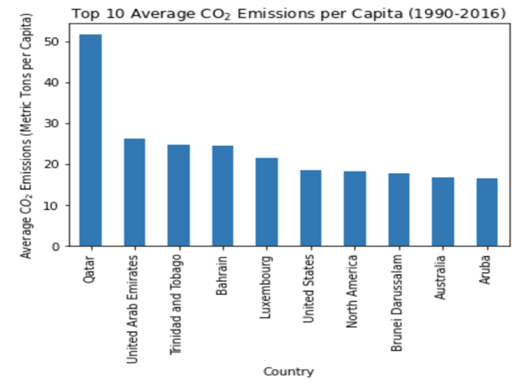
Total CO2 Emissions by Region
The United States was the
6th greatest producer of CO2 across the interval measured.
Andrew
World Bank: https://climateknowledgeportal.worldbank.org/download-data

Slide 5
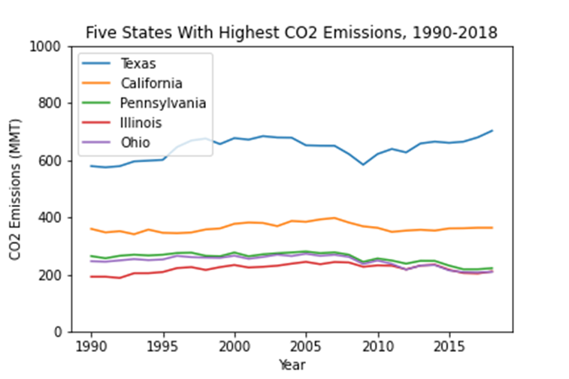
Total CO2 Emissions by State
State CO2 emissions have remained largely constant
over time.
EIA: https://www.eia.gov/environment/emissions/state/
Andrew

Slide 6
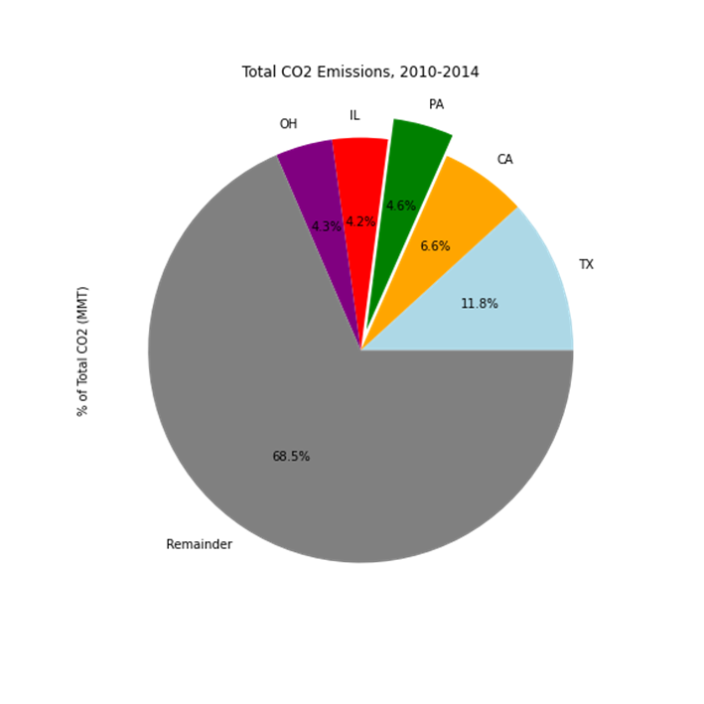
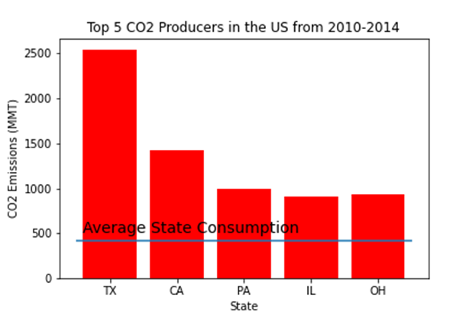
Top 5 CO2 Producers by State, 2010-2014
The top five states with the greatest emissions
account for 31.5% of national emissions.
Andrew
EIA: https://www.eia.gov/environment/emissions/state/

Slide 7
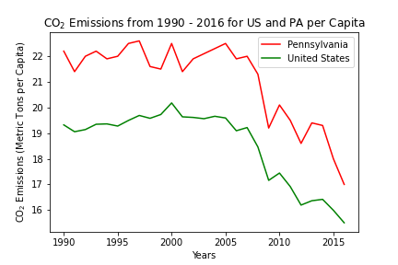
CO2 Emissions per Capita
https://climateknowledgeportal.worldbank.org/download-data
https://www.eia.gov/environment/emissions/state/
Dipesh

Slide 8
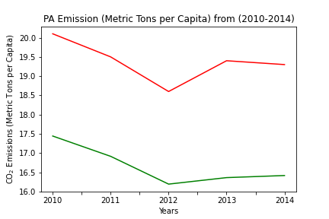
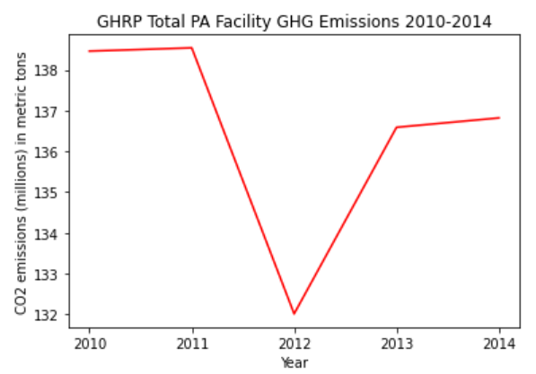
CO2 Reported Emissions:
Facility vs. Per Capita
https://climateknowledgeportal.worldbank.org/download-data
https://www.eia.gov/environment/emissions/state/
Dipesh

Slide 9
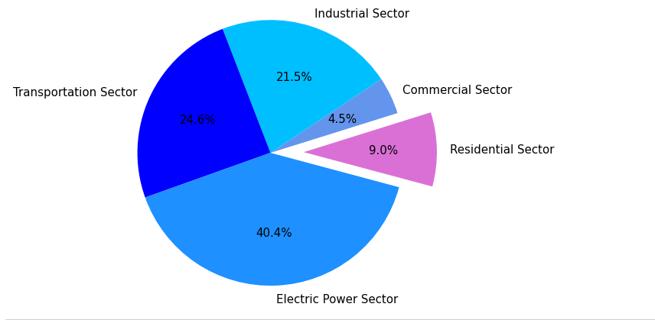
Total Carbon Dioxide Emissions from Fossil Fuel Consumption in Pennsylvania by Sector (2014)
https://www.eia.gov/environment/emissions/state/
Anthony

Slide 10
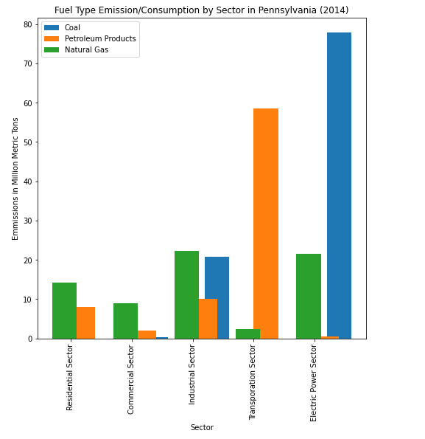
Emission Type by Sector in PA
Observations:
Coal
Residential
Transportation
Electric Power
Residential vs. All Sectors
https://www.eia.gov/environment/emissions/state/

Slide 11
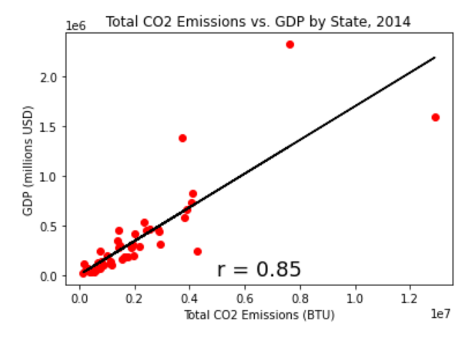
Total CO2 vs. GDP by State (2014)
Megan

Slide 12
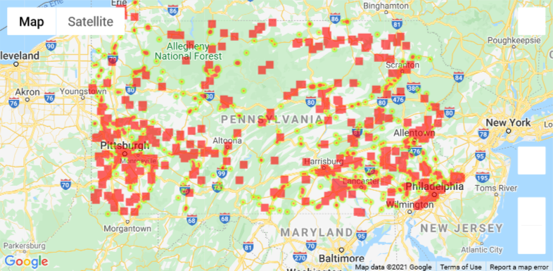
Heatmap of Total CO2 Emissions by facility (2010-2014)
Source: https://www.kaggle.com/jaseibert/us-facilitylevel-air-pollution-20102014
Megan

Slide 13
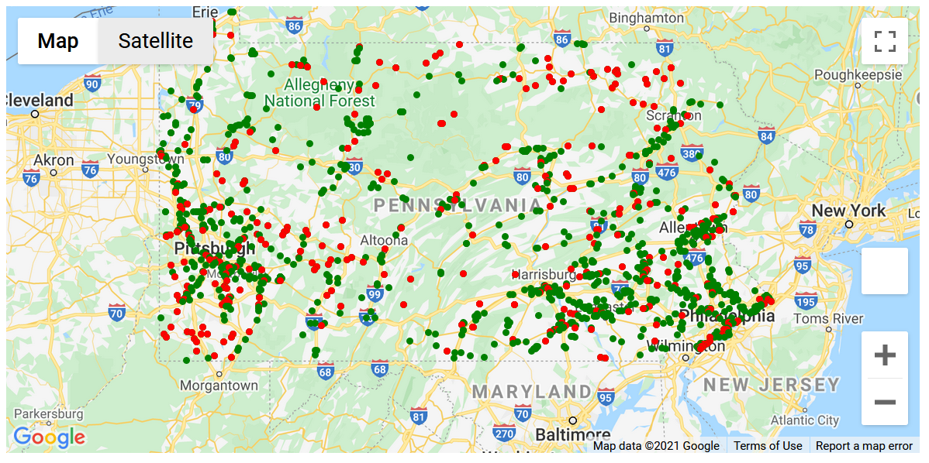
PA Facilities CO2 Emissions (2010-2014)
On average from 2010-2014, only 21.2% of facilities (1,367) listed in the data set reported their CO2 emissions.
Red - facilities reported
Green - facilities not reported
Megan
Source: https://www.kaggle.com/jaseibert/us-facilitylevel-air-pollution-20102014

Slide 14
Conclusions/Extrapolations
CO2 vs. other GHGs
Correlation between GDP and CO2
Commercial and Industry sectors have an incentive to not report.
Accountability and lack of reporting
Why did we choose to visualize what is missing?
Per capita and residential sector vs. all other sectors in PA
Individual changes vs. broad systemic change and firm policy (national, statewide, and local)
Policy: reporting and accountability
Timeline

Slide 15
Sources
https://www.eia.gov/environment/emissions/state/
https://www.kaggle.com/jaseibert/us-facilitylevel-air-pollution-20102014
https://www.kaggle.com/lislejoem/us_energy_census_gdp_10-14
https://climateknowledgeportal.worldbank.org/download-data
Megan

Slide 16
Context and Limitations
Context
IPCC Report (2018)
Climate Change
CO2 Emissions
Global Temperature Rise
Potential Outcomes
Deadline
Federal Resolutions
US Clean Future Act
Green New Deal
Limitations
CO2 vs. other GHGs
Datasets
Policy on reporting
Anthony

